Slide 1








Officially sanctioned
DEFCON shenanigan*
Warranty VOID
if not removed
*Not really, but Noid said we could do it, it was cool
ATTENTION:
Some advertised claims are only valid if
intoxicated and/or under the influence of
very strong psychoactive substances.
NOTICE
Contains RFID
and GPS Tracking
I do not fucking
care for your shit
Want to be a crab?
Ask me how TODAY!
We’ve been trying to
reach you about your
car’s extended warranty
Test that assumption at
your earliest convenience
#DuckArmyInvasion
NOTICE:
This package most likely doesn’t
contain wasps, hornets, and/or bees.
STFU and go
finger paint

Slide 2



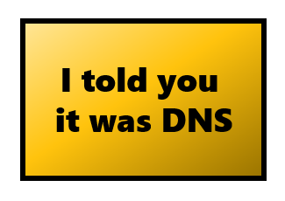






Your query is consuming
excessive resources.
Learn more
You are being observed. Any
attempt to discuss blockchains
will be dealt with inappropriately.
A7
中國海關檢查
Inspected by Chinese Customs
EAT
SLEEP
SOLDER
REPEAT
Some people appear to
have bad luck when it
comes to critical thinking

Slide 3





DANGER
Godzilla Hazard
Pretend to read the directions
carefully and do whatever the
hell you think might be the
right way and then whine
about why it doesn’t work.
WARNING!
Please use extreme caution when
Yeeting scooters off the bridge
Please avoid contact with
holy water and anyone that
uses ketchup on steak
Caution
Extreme Chaos Area
NO EYE CONTACT
$500 FINE
WARNING!
Please obey all laws of physics, time,
and space or face criminal charges
including fines and/or jail time

Slide 4







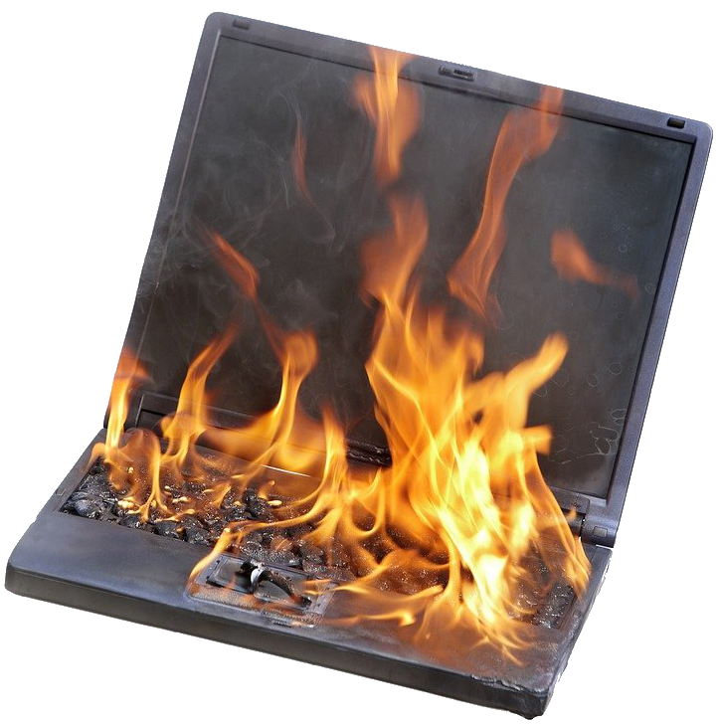


To err is human.
To really fuck things up,
you need a computer.

Slide 5









Buy an NFT?
Please don’t click
all the things
No Fucking Thanks
THIS SERVER
MAY CONTAIN
CRYPTOCURRENCY
Sponsored by ^C/^V
The League of
Extraordinary
Shitposters
The League of
Extraordinary
Shitposters
!
STOP! This is now an NFT, it can be located on the blockchain.
DO NOT PHOTOGRAPH OR SCREENSHOT
These materials may
have been obtained
through shitposting
PLEASE
Keep the two way
mirror clean!
Thank you!
Shove as many bees into your
mouth as you possibly can
THIS MACHINE
WILL BE USED
FOR GOOD AND EVIL
WARNING!
Please use cinder blocks when
Yeeting developers off the bridge

Slide 6




It gets worse
To err is human.
To really fuck things up,
you need a computer.
NOTICE
Toilet Cameras are for research
purposes only.
before it gets worse
Tampering with or disabling the toilet
cameras is a Federal Crime punishable up
to $8,500 in fines.
Remember once you address root cause and make
it so that will never happen again, something will
happen to where you need to do the thing that you
shouldn’t do any more.
For Questions, Comments and Complaints,
Please call 1 (800) 948-8488
IF FOUND, DROP IN ANY MAILBOX
RETURN POSTAGE GUARANTEED
NO. 223934
PROPERTY OF
FBI SURVEILLANCE VAN
NO. 17

Slide 7





WARNING:
The software installed on this device
is only used to simulate security and
will provide no protection.
Just roll the whole
thing up into a giant
pizza cigar and eat it
like a caveman
-@dildog reacting to the horror that is tavern style pizza
?
Just because you can
do a thing, does that
mean you should?
Please take me
away now
Threatbutt
Please don’t legitimize us.
DON’T FORGET
OPEN BAR – FREE FOOD
10PM UNTIL ????
Welcome to
Camp “Fuck you I’m a wizard”
Camp Rules:
Drinking
Magic

Slide 8





?
You're literally academically
unqualified to asses my work
PhD||GTFO
SHUT THE
FUCK UP
ZONE
Troubleshooting
checklist
Scan this QR Code for
a free random NFT
Applications
Ordinance 1337.69 Max, $1000 fine
Seriously, we really don’t need to hear it.
Servers
The spider infestation
problem is mostly
resolved
Networking
Yes, this includes DNS

